Slide 1
Open Innovation for Sustainable Global Mobility
BlueberryCider

Slide 2
Electric Vehicles
Electric vehicles (EVs) are a type of vehicle that uses electricity as its primary source of power for propulsion. Unlike traditional internal combustion engine (ICE) vehicles, which rely on gasoline or diesel fuel, EVs use electric motors and rechargeable batteries to generate the energy needed to drive the vehicle.
They include Battery Electric Vehicles (BEVs), Plug-in Hybrid Electric Vehicles (PHEVs), Hybrid Electric Vehicles (HEVs), and Extended Range Electric Vehicles (EREVs). EVs have electric motors, battery packs, and charging systems.
They are known for their environmental benefits, producing zero tailpipe emissions, and are becoming more popular due to technological advancements and efforts to reduce air pollution and combat climate change.

Slide 3
Why move to EV ?
Switching to electric vehicles (EVs) offers numerous advantages, including environmental benefits such as reduced greenhouse gas emissions and improved air quality. Economic benefits include lower operating costs and reduced dependence on imported oil. EVs provide better performance with instant torque, quieter operation, and lower centers of gravity.
They benefit from technological advancements like improved battery technology and integration with renewable energy sources. Governments often offer incentives, and EVs require less maintenance, contributing to long-term cost savings. Additionally, the shift to EVs aligns with the global transition to sustainable, low-carbon energy sources, making them a compelling choice for individuals and society.

Slide 4
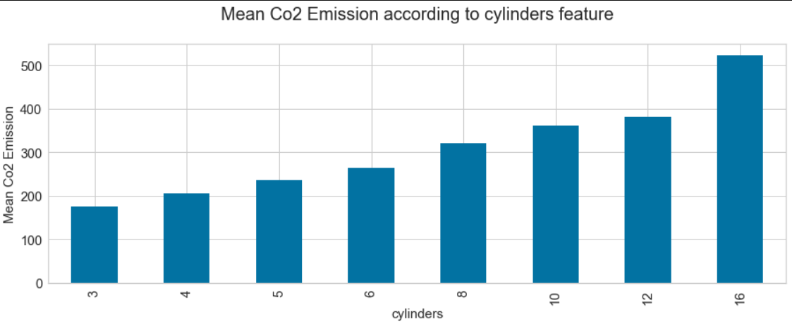
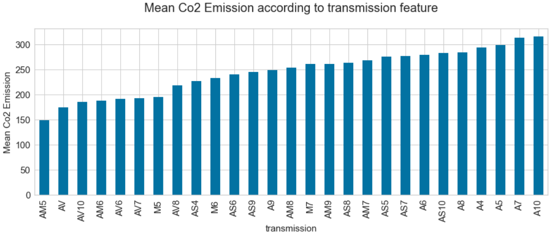
Analysis on the cos2 emissions produced by vehicles

Slide 5
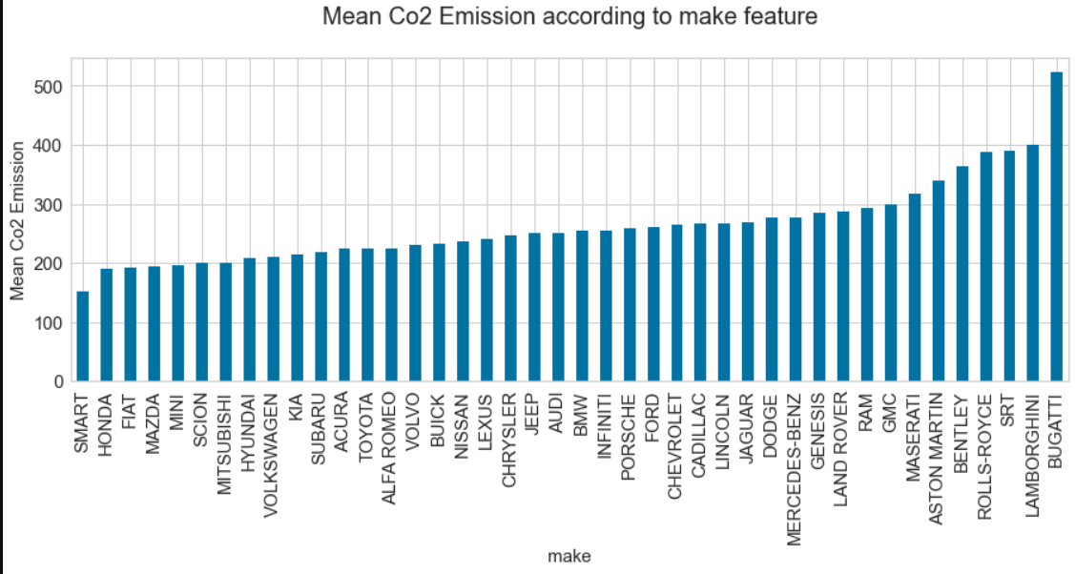
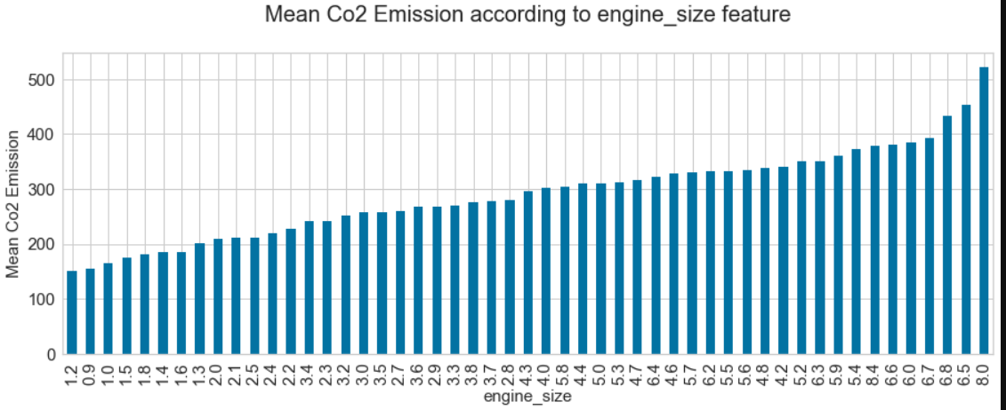
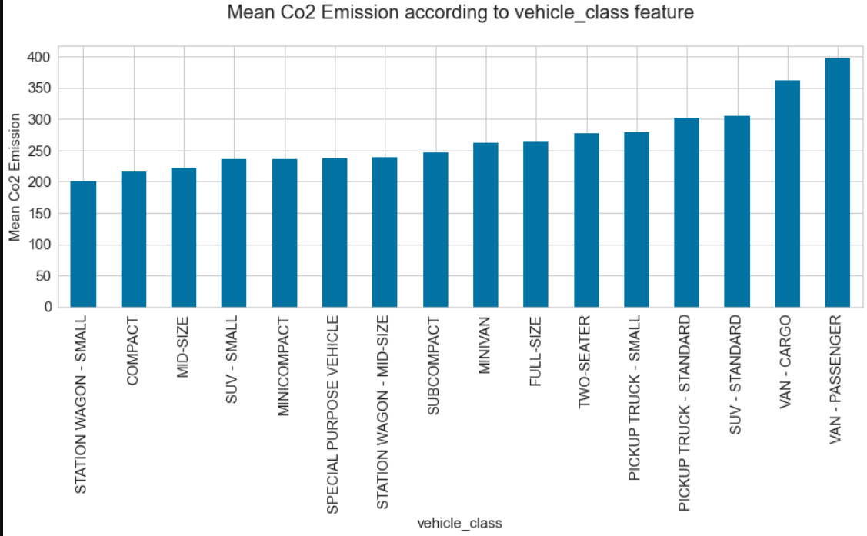
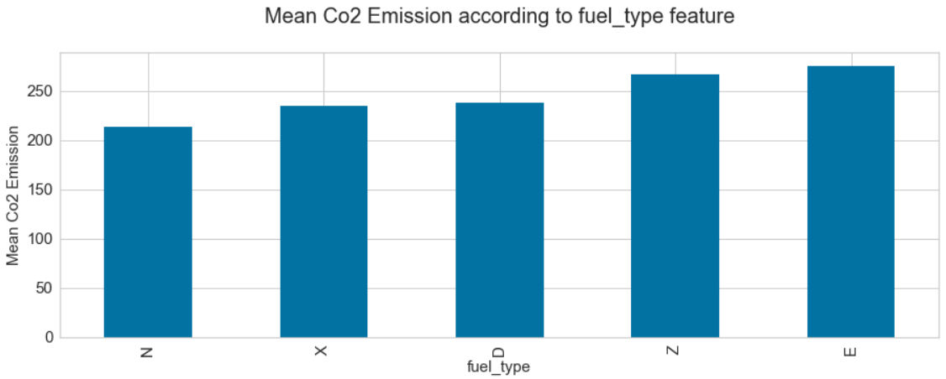

Slide 6
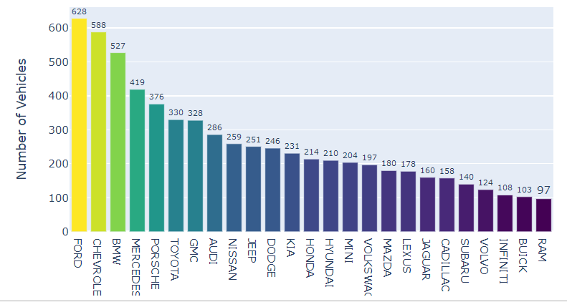
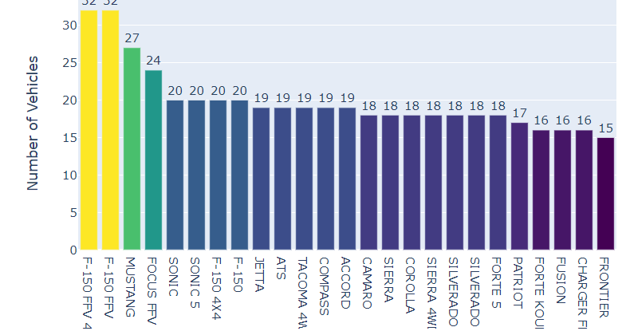
Number of vehicles with respect to make and model

Slide 7
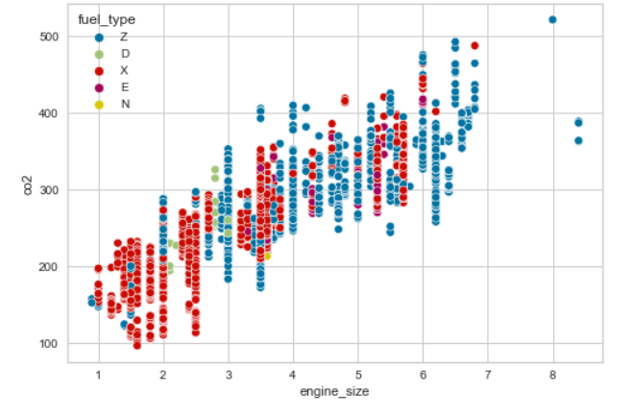
Scatter plot

Slide 8
Conclusion
As we can infer from the analysis switching to electric vehicles (EVs) is a crucial response to the rise in carbon dioxide (CO2) emissions from vehicles. EVs produce zero tailpipe emissions, significantly reducing greenhouse gas emissions and combating climate change. This transition encourages the use of cleaner electricity sources, such as renewables, and aligns with government initiatives and incentives. EVs also improve air quality and human health by emitting fewer pollutants. As technology advances and battery efficiency improves, EVs are becoming more sustainable and practical, contributing to a low-carbon economy. While EV adoption is essential, its success depends on factors like the electricity grid's carbon intensity and charging infrastructure development.

Slide 9
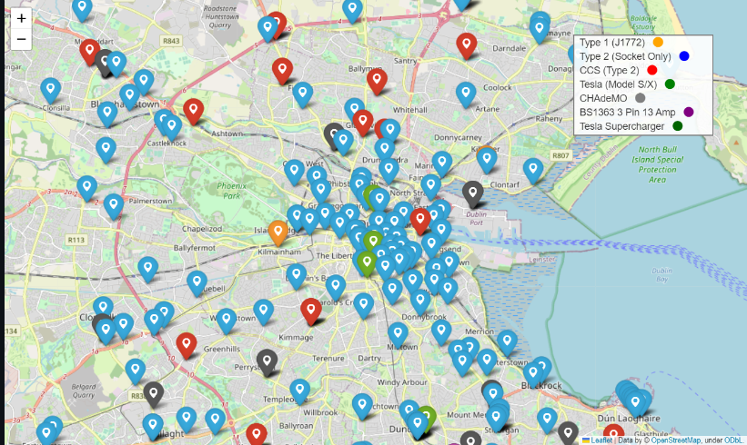
Optimal EV CHARGING LOCATIONS
The area we’ve taken to work with is Dublin which is in Ireland as there are very less number of EV charging stations in the major cities of India. This code would work for any given area.
To check the number of EV charging stations in a given area we’ve used OpenChargeMap API.
We’ve used the API to get all the exisiting EV stations withtin a 25km raidus from the centre of Dublin
There were a total of 333 EV Charging Points in the chosen radius as opposed to Banglore which has only 5.

Slide 10


Slide 11
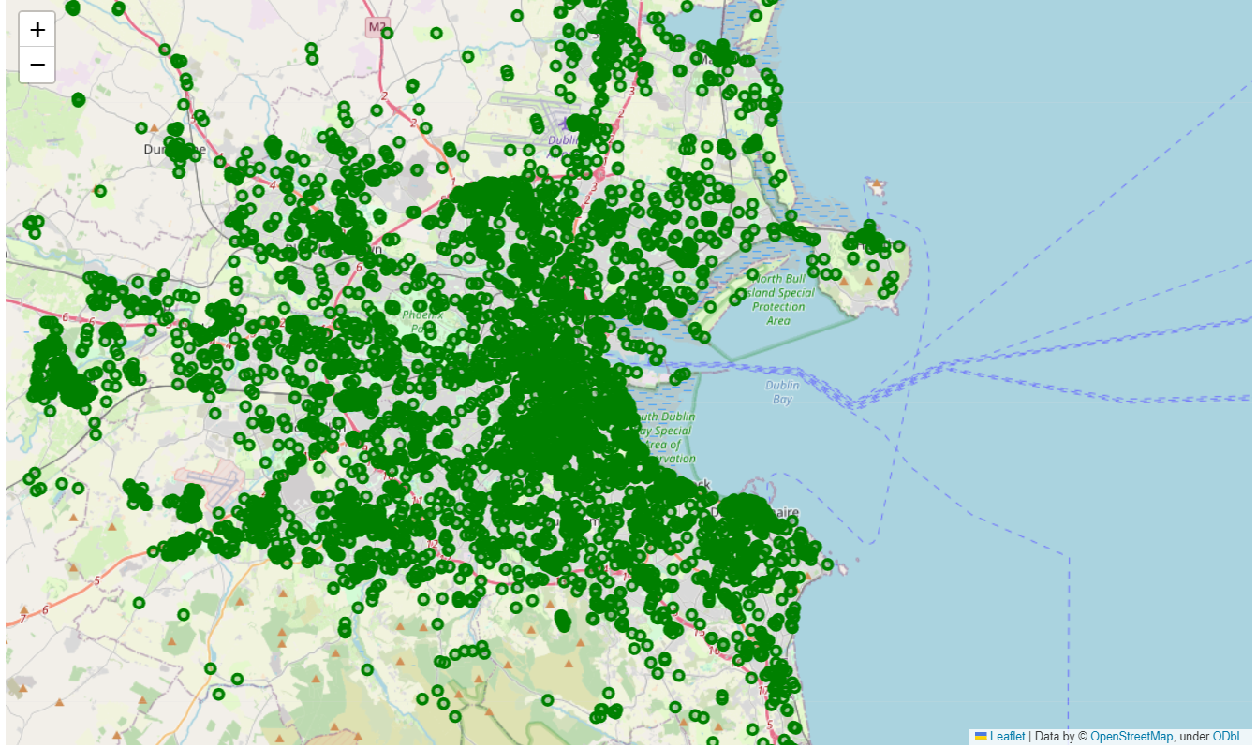
Major hotspots
We’ve used the osmnx library to work with OpenStreeMap data.
OSM data has a feature called ‘amenity’ which accurately tags each coordinate to a particular category.
Based on looking at the list of available ‘amenity’, we’ve finalized on the following tags as they satisfy our criteria of a hotspot : [fuel, parking, events_venue, college, hospital, university, food_court, exhibition_centre, townhall, stadium, conference_cetre]
There were a total of 6599 hotspots avaialbe in the chose raidus

Slide 12
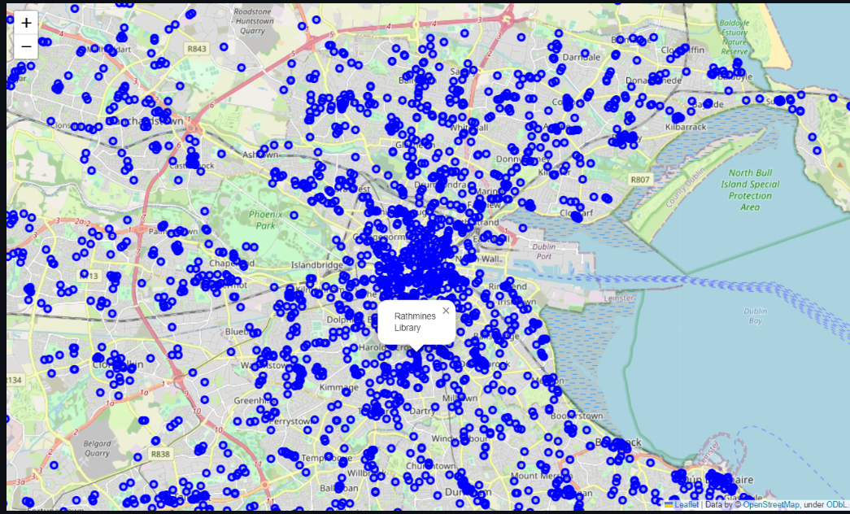
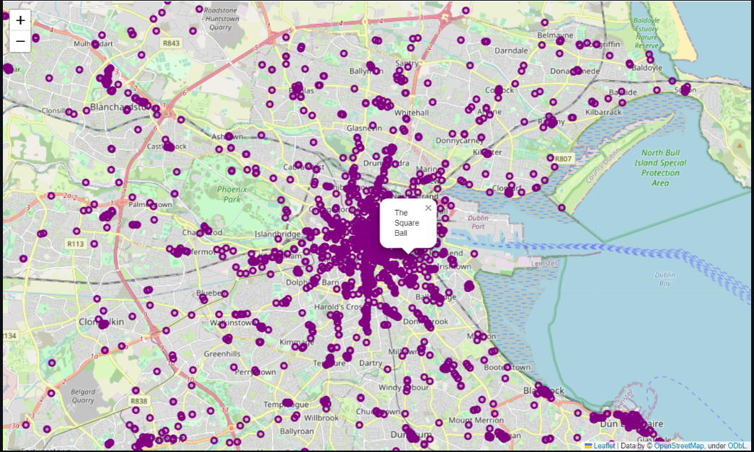
Public Service spots and places of recreation
['school', 'pharmacy', 'place_of_worship', 'bank', 'doctors', 'kindergarten', 'social_facility', 'post_office', 'clinic', 'childcare', 'library', 'police', 'veterinary', nursing_home', post_depot', 'fire_station', 'courthouse’] - 3186 spots
['restaurant', 'cafe', 'pub', 'bar', 'theatre', 'arts_centre', 'cinema', 'nightclub’] - 3128

Slide 13

Objective Function
The function gives more priority to
public spots and recreation spots
and less priority to EV Charging locations.
Therefore an optimal EV charging location
would be where there are more public
and recreation spots and less EV charging
spots

Slide 14
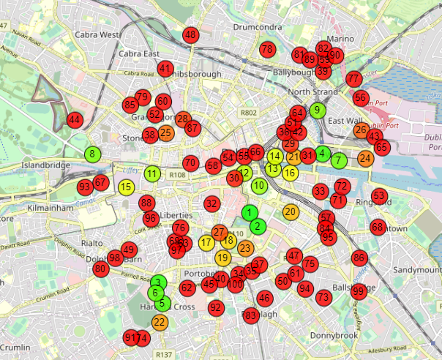
Optimal charging locations
Most Optimal Spots Ranked by numbers
where the score 100 is the most optimal
and 1 being the least optimal.

Slide 15
Future work
More time needs to be spent on coming up with a suitable objective function based on comprehensive field research, domain expertise, and alignment with policy requirements
The analysis did not encompass factors such as new EV station setup costs, land acquisition expenses, private/public access. Access to such data would significantly broaden the depth and applicability of our analysis
The establishment of new EV stations would inevitably impact the current power grid, necessitating a cautious integration aligned with the existing load structures. This aspect offers potential for further comprehensive analysis and consideration
As this code works in the backend to give the optimal locations, Once established a website/app which would suggest the nearest public / recreation spot to an EV charging location can be made.

